Slide 1
Do Voting Machine Cause Lost Votes?
17.871
Spring 2012

Slide 2
2000 Presidential Election

Slide 3
2000 Presidential Election

Slide 4
2000 Presidential Election

Slide 5
How do we know if some voting machines are more prone to “lost votes” than others?
If some are prone to more lost votes than others, how big of a problem is it?

Slide 6
How do we know if some voting machines are more prone to losing votes than others?

Slide 7
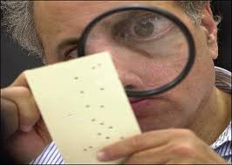
How do we know if some voting machines are more prone to losing votes than others?
Law

Slide 8
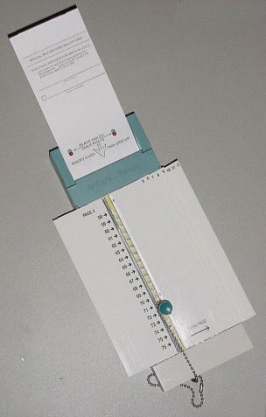
How do we know if some voting machines are more prone to losing votes than others?
Engineering

Slide 9
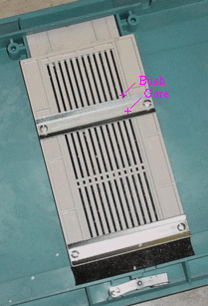
How do we know if some voting machines are more prone to losing votes than others?
Engineering

Slide 10
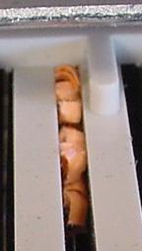
How do we know if some voting machines are more prone to losing votes than others?
Engineering

Slide 11
How do we know if some voting machines are more prone to losing votes than others?
Tech. | Under-vote pct. | Over-vote pct. | Lost vote pct. | Number of counties
Datavote (punch) | 0.83% | 6.10% | 6.93% | 9
Hand-count | 0.65% | 6.09% | 6.74% | 1
Lever | 0.29% | 0.09% | 0.38% | 1
Optical scan | 0.31% | 1.05% | 1.36% | 41
Votomatic (punch) | 1.52% | 2.42% | 3.94% | 15
Statewide | 1.03% | 1.91% | 2.94% | 67
Data sources:
Election returns: Florida Division of Elections
Over- under-vote counts: NORC recount project
Statistics, correlational

Slide 12
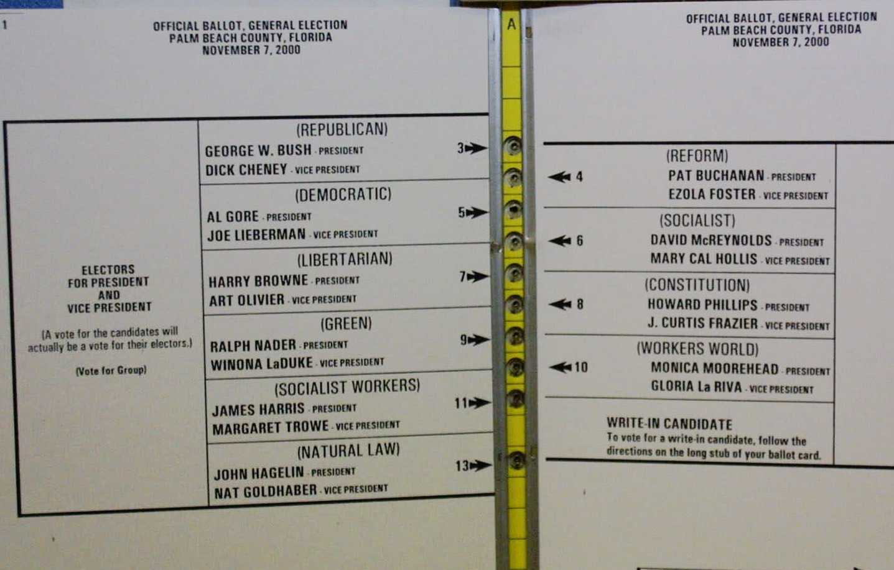
An Aside: The Butterfly Ballot Mattered

Slide 13
Many Columns Are Bad
 | Number of ballot columns
Technology | 1 | 2 | Total
Datavote (punch) | 7.09% (7) | 6.73% (2) | 6.93% (9)
Hand-count |  | 6.74% (1) | 6.74% (1)
Lever | 0.38% (1) |  | 0.38% (1)
Optical scan | 0.89% (27) | 7.03% (14) | 1.36% (41)
Votomatic (punch) | 2.91% (13) | 8.07% (2) | 3.94% (15)
Total | 2.06% (48) | 7.81% (19) | 2.94% (67)

Slide 14
How do we know if some voting machines are more prone to losing votes than others?
 | Machine in 2000
Machine in 1988: | Votomatic | Lever | Opscan | DRE | Total
Votomatic | -0.52% (171) |  | -1.96% (179) | -0.40% (8) | -0.98% (365)
Lever | -0.69% (2) | -0.08% (114) | -0.24% (65) | 0.66% (111) | 0.03% (294)
Opscan |  |  | -1.42% (74) | -0.84% (1) | -1.33% (75)
DRE |  |  |  | -1.92% (35)
Total | -0.92% (215) | -0.08% (119) | -1.29% (616) | -0.94% (65) | -0.81% (1,402)
(Quasi-)
Experimental
Note: the table isn’t complete, although the totals in the columns and rows reflect the entire table

Slide 15
Some points relevant to 17.871
Political science can provide a service to society by framing questions causally, and reducing complicated matters to clear observables.
Addressing important questions of public policy requires creative combinations of insight, data, and method.

Slide 16
Relevant to the Syllabus (to come)
Statistics

Slide 17
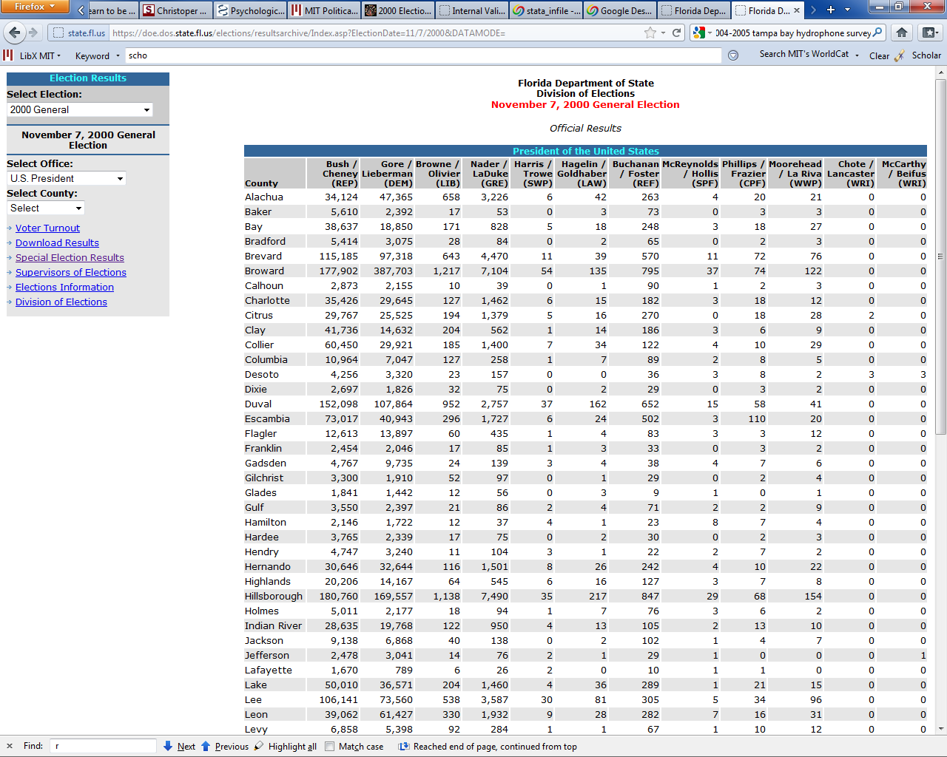
Relevant to the Syllabus (to come)
Statistics
Mechanics

Slide 18
Relevant to the Syllabus (to come)
Statistics
Mechanics
Project

